Slide 1

EEG classification using Neural Network – An Application of Machine Learning in Classification of attention deficiency, to measure the effect of ChakaMarkaKosha Meditation-II
By Sreekanth gopI
Kennesaw State university

Slide 2

AGENDA
ABSTRACT
RESEARCH QUESTION & INTRODUCTION
CHAKRAMARMAKOSHA MEDITATION
METHODOLOGY
RESULTS & CONCLUSION

Slide 3
abstract
Stress reduces attention span and is a common problem that impacts students’ academic performance as well as their self-efficacy in handling challenging situations.
A new version of ChakraMarkaKosha Meditation - CM-II as a guided psychotherapy and cognitive therapy meditation is developed by me.
The aim is to to analyze its impact on reducing attention deficiency among students.
For this, this study uses Electroencephalography (EEG) data as a metric to analyze electrical activities of the brain that contribute to attention deficiency.
We use neural network as a machine learning classifying algorithm to analyze the EEG data to measure the impact of CM-II on students’ attention deficiency.

Slide 4
Research questions
Can a machine learning algorithm detect accurately attention deficiency through spectral analysis of EEG data? (phase 1)
Does ChakaMarkaKosha Meditation II improve attention and increase students’ self-efficacy? (phase 2)

Slide 5
introduction
Attention is one of the cognitive skills that involves concentration on problem-solving, judgment, and language (read/write).
Attention-Deficit Hyperactivity Disorder (ADHD) is a neuro-developmental disorder that is characterized by hyperactivity and inattentiveness.
As EEG can help in detecting signals that contribute to ADHD, we use a public EEG dataset of 60 ADHD and non-ADHD participants to train our developed machine learning classifier.
Multi-layer Perceptron (MLP), a feedforward artificial neural network, is a fully connected multi-layer neural network that we use in the classification of ADHD in each dataset.

Slide 6
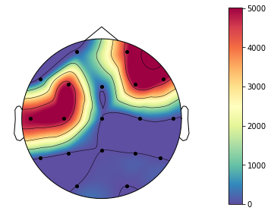
My Contribution
Visualized the EEG data to see ADHD and non-ADHD brain scan using MNE library in Python.
Extracted Alpha (α), Beta (β), and Theta (θ) band features (Fig. 4)
Applied Multi-layer Perceptron (MLP) in the classification of ADHD. Obtaining 69.2% accuracy in detecting attention deficiency.
Additional metrics to be designed in the next phase to measure change in attention span after meditation.

Slide 7
Chakramarmakosha II meditation
CM-II is a sequel of CM in which the script focuses on improving individual’s attention and self-efficacy.
It guides the user through their emotional memories and release past painful emotions associated with a trauma.
For instance, individuals with acute stress disorder may have significant psychological issues and distress that could have arisen from past stored emotions. In addition, they may also have distorted cognitions formed from convictions during trauma that keep them under stress.

Slide 8
Chakramarmakosha II meditation
CM-II addresses these issues by guiding the listener through past emotional release and cognitive restructuring.

Slide 9
hypothesis
The hypothesis is that
CM-II improves attention, increases students’ problem-solving skills, and self-efficacy. CM-II’s effect will be measured primarily by live EEG data in phase II of the research.

Slide 10
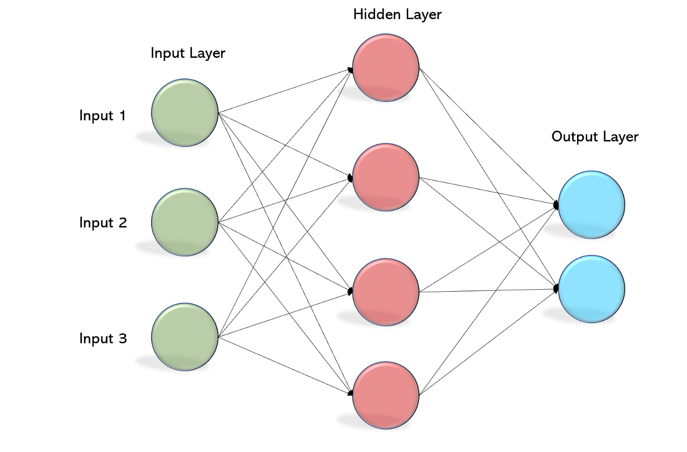
Machine learning Classifier
In this project, the dataset from Mohammadi et al.’s study is used to do a ML classification based on Neural Networks.
30 kids (22 boys and 8 girls around 10 years of age) who had been diagnosed with ADHD by a skilled psychiatrist and 30 kids who were healthy controls (25 boys and 5 girls) participated in the study.
19 channels (Fz, Cz, Pz, C3, T3, C4, T4, Fp1, Fp2, F3, F4, F7, F8, P3, P4, T5, T6, O1, O2) of EEG
The deep learning technique known as CNN, or Convolution Neural Network, usually has four layers: an input layer, a pooling layer, a fully connected layer, and an output layer.
Multi-Layer Perceptron (MLP) that has forward-feed and back-propagation learning method is chosen here as we expect higher accuracy.
Notes:
the model was trained with a batch size of 32 and 200 epochs.

Slide 11
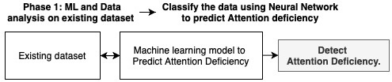
methodology

Slide 12
methodology
To achieve classification for inattention by EEG, the following steps were followed:

Slide 13
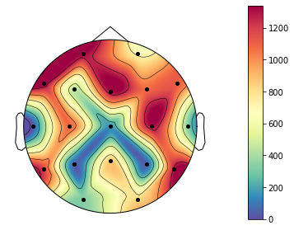
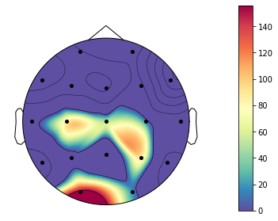
Data visualization
Visualized the EEG data to see ADHD and non-ADHD brain scan using MNE library in Python. Visualized EEG waves using MatplotLib. (samples in Fig. 1 and Fig. 3)
ADHD – Darker colors in frontal region
Non-ADHD – Lighter colors in frontal region

Slide 14
Feature selection and extraction
Estimated power spectral density using Welch's method - Fourier analysis and frequency band calculations .
Computed the absolute power by approximating the area under the curve. Band powers of Alpha (8-13Hz), Beta (13-21Hz), Delta (2-4Hz), and Theta (4-8Hz) bands were extracted as they help in identification of ADHD.
CSV files were created for each channel which contain the absolute band wave values. These values were fed into the ML models thereafter.

Slide 15
Development and training of MLP
Absolute band values were calculated and fed as input to the ML model. A new dataset was created from frequency bands using TensorFlow library and 19 csv’s were exported.
Then a neural network model was made using TensorFlow and Keras libraries.
Binary Cross Entropy loss function was used for optimization using Stochastic Gradient descent.
Thereafter, the model was trained (TrainSet – 0.8, ValidationSet – 0.1, & TestSet 0.1) with a (Batch size – 32; epochs - 200).
Model Evaluation: Then this model was tested using the partitioned test data set and accuracy were calculated. A confusion matrix also was created from sklearn library functions to visualize the performance of the classification.

Slide 16
methodology
Other classifiers such as SVM, Random Forest, XGBoost, and Decision tree was also implemented using skLearn library. Accuracies were compared to see the classifier based on the best performance.

Slide 17
Results and conclusion
The goal of this study is to
1) use neural network classification ML algorithm to detect attention deficiency by using EEG dataset, and
2) analyze the impact of CM-II on individuals with attention deficiency.

Slide 18
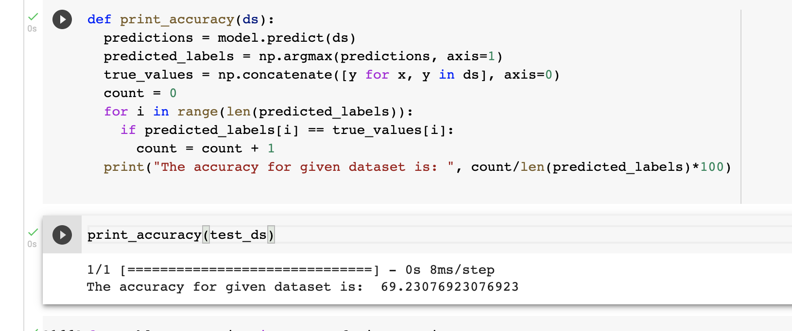
Results and conclusion
For goal 1, we used Multi-layer Perceptron (MLP) on bandwidths of α,β,δ,θ bands obtained from 19 channels of raw EEG dataset.
The algorithm produces an accuracy of 69%.

Slide 19
MLP Conclusion
Created MLP model is producing unstable accuracies (Ranging 45-69%) and the best was 69%. Need larger dataset to get stable predictions.
Notes:
K-nearest Neighbors (69%), Support Vector Machines (72%), and Random Forest (74%) was found to have the highest accuracy (84%) on a similar dataset.

Slide 20
9 other classifiers Accuracies CODED Using sklearn library:
Random Forest: 73%
XGBoost: 71%
SVM: 71%
Decision Tree: 66%.
MLP 72%
Logistic Regression: 67%
Naïve Bayes – 60%
KNN - 75%
AdaBoost – 70%
Bagging – 70%
LDA - 68
F1 scores did not make any significant difference
Notes:
Naïve Bayes, KNN - 64%, AdaBoost – 69%, Bagging – 67, LDA – 68 Not in submitted Code but can provide on request.

Slide 21
Notes:
K-nearest Neighbors (69%), Support Vector Machines (72%), and Random Forest (74%) was found to have the highest accuracy (84%) on a similar dataset.

Slide 22
CONCLUSION – other classifiers
KNN produced 75%.
RANDOM FOREST produced 72% for the given EEG dataset.
In future, we could improvise the performance of KNN and Random Forest Classifier.
Notes:
K-nearest Neighbors (69%), Support Vector Machines (72%), and Random Forest (74%) was found to have the highest accuracy (84%) on a similar dataset.

Slide 23
MLP FUTURE IMPROVISATION
Data Pre-processing: Remove artifacts include noise from electrical lines, muscle movement, heart-beat, sweating, electrode movement, and so on.
Feature Selection: Feature eliminations using different component analysis to simplify the complexity in high-dimensional data while retaining trends and patterns.
Feature Engineering: Band wave Ratios and deeper spectral analysis could lead to extract the most important information from the signals.
Chaos: Study chaos in EEG as it has non-linear processes with high fluctuations.
Non-Linear Feature analysis; To extract important nonlinear features from EEGs.
Notes:
K-nearest Neighbors (69%), Support Vector Machines (72%), and Random Forest (74%) was found to have the highest accuracy (84%) on a similar dataset.

Slide 24
Next Research (Phase 2)
Data collection and running the experiment
In the next phase, the study will continue to improve the model’s accuracy and stability.
TBR – Bandwave Ratio to be more analysed.
Specialized Channels – Cz, Fz effects to be studied.
Lower alpha and beta bands and larger theta and delta bands
In addition to EEG, a self-efficacy standard test, and heart coherence measurements will be included as metrics.
Then, an experiment will be conducted on 10-15 participants to analyze their live EEG scans to measure their attention deficiency as well as its improvement after CM-II meditation (Fig. 6).

Slide 25
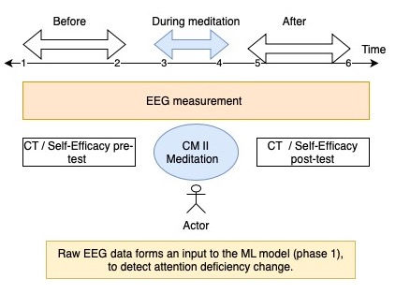
Methodology Phase 2

Slide 26
REFERENCES
Mohammadi, M. Ret al.,. (2016). EEG classification of ADHD and normal children using non-linear features and neural network. Biomedical Engineering Letters.
Nelles, O. (2020). Nonlinear system identification: from classical approaches to neural networks, fuzzy models, and gaussian processes.
Theodoridis et al., (2010). Introduction to pattern recognition: a matlab approach. Academic Press.
Shubham Dhuri et. al., International Research Journal of Engineering and Technology (IRJET).
Lubar JF. Discourse on the development of EEG diagnostics and biofeedback for attention-deficit/hyperactivity disorders. Biofeedback Self-Reg 1991. Mohanty, A. (2019, May). Multi layer Perceptron (MLP) Models on Real World Banking Data.

